Slide 1



AUTONOMOUS SHIPPING Sprint 5
Jasper Vlaar, Jelte Molenaar, Job Vink, Michiel van Soest en Martin de Rijke

Slide 2
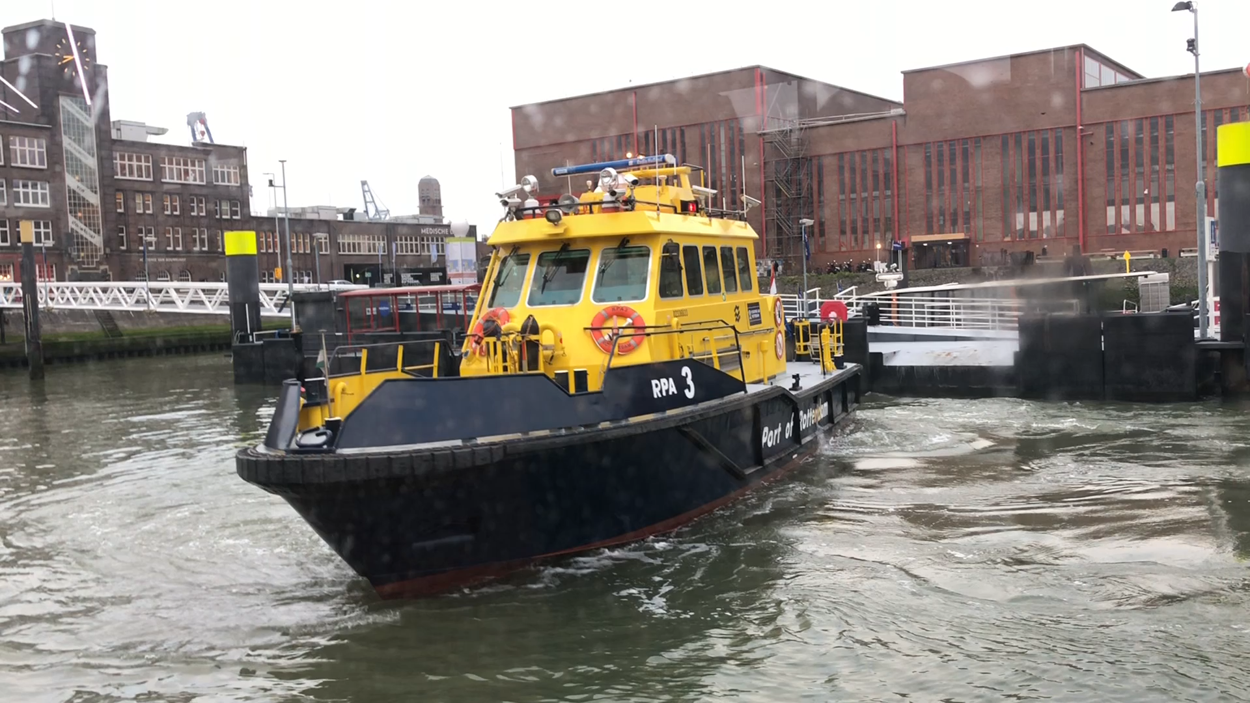
Autonomous shipping

Slide 3
Current scope
Wall detection
Improving algorithm
Introducing new techniques
Distance recognition
- Research
System validation
Hyperparameter tuning

Slide 4
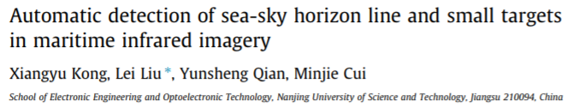
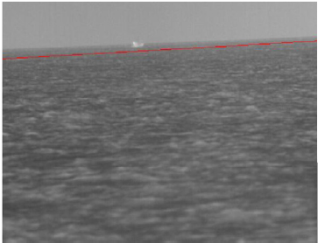
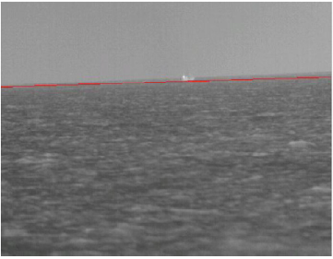
Using horizon detection

Slide 5
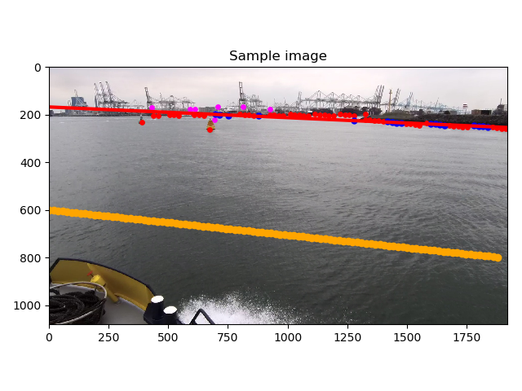
Using r-value to split lines
Find points
Linear fit
Check r-value
Below treshold
Split point set
Above treshold
Done!

Slide 6
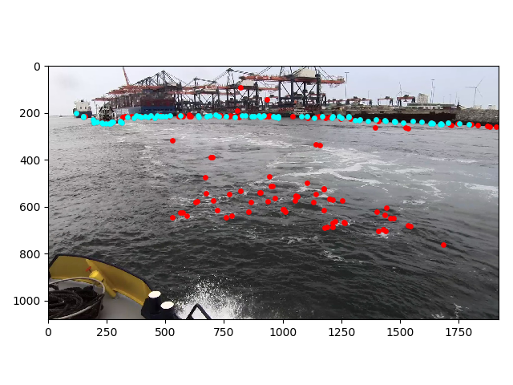
Labeling tools & hyperparametering

